Slide 1
NON-STATIONARY EXTREME VALUE ANALYSIS IN A CHANGING CLIMATE
Zehao Zhang, Zi Hua Xu Statistics and Actuarial Science
Notes:
This paper mainly introduces the working principles of the NEVA MATLAB package, which is designed for non-stationary extreme value analysis. It also includes a case study to demonstrate how the tool can be applied in practice.

Slide 2
Intro
This presentation mainly introduces the working principles of the Process-informed Non-stationary Extreme Value Analysis (ProNEVA) MATLAB Toolbox, which is designed for non-stationary extreme value analysis. It also includes a case study to demonstrate how the tool can be applied in practice.

Slide 3
Outline
Theory
Case study
Discussion

Slide 4
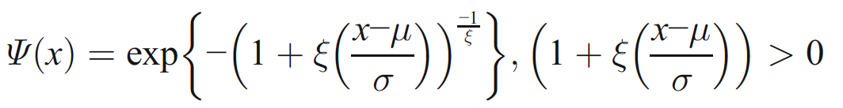
Theory: Generalized Extreme Value (GEV) distribution
μ (location parameter)
specifies the center of the distribution
σ (the scale parameter)
determines the size of deviations around the location parameter
ξ (the shape parameter)
governs the tail behavior of the GEV distribution

Slide 5
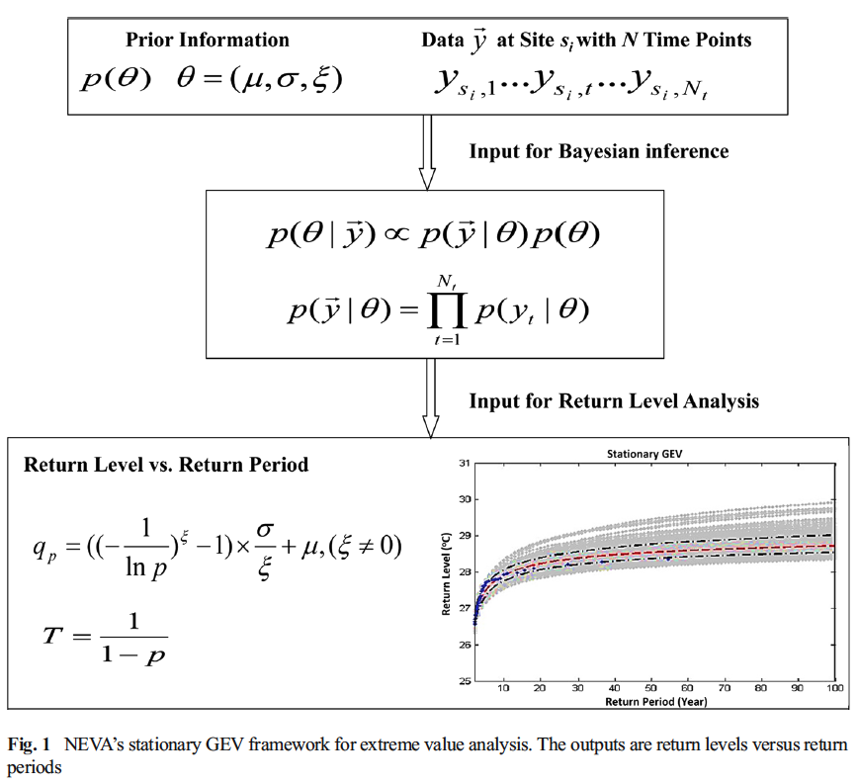

Slide 6
Theory: Markov Chain Monte Carlo(MCMC) simulation
In Bayesian analysis, the posterior distribution is often difficult to compute analytically
MCMC is used to approximate the posterior by generating samples from it
This paper uses a hybrid approach called Hybrid-evolution MCMC.
Runs multiple chains in parallel, which share information dynamically
Incorporates Intelligent initialization, Adaptive Metropolis (AM) proposals, Differential Evolution (DE) for global search and Snooker update strategies for efficient moves
Key advantages:
Combines global and local search (DE + MCMC)
Efficiently explores high-dimensional/posterior spaces
Proven to provide faster convergence and robust sampling

Slide 7
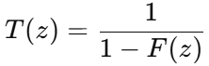

Return Level & Return Period
Return period:
the average time between events of a certain size or bigger
e.g. A 40°C heatwave with a 20-year return period
Return level:
the level of an event that, on average, is exceeded once every T years
e.g. A 40°C heatwave with a 20-year return period
Formula:
RP:
RL:
where F(z) is the cumulative distribution function (CDF) of the extreme value distribution

Slide 8
inverse function

Slide 9
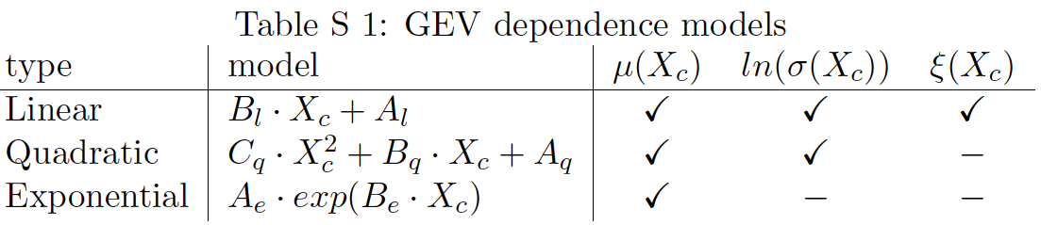
Theory: Non-stationary part

Slide 10
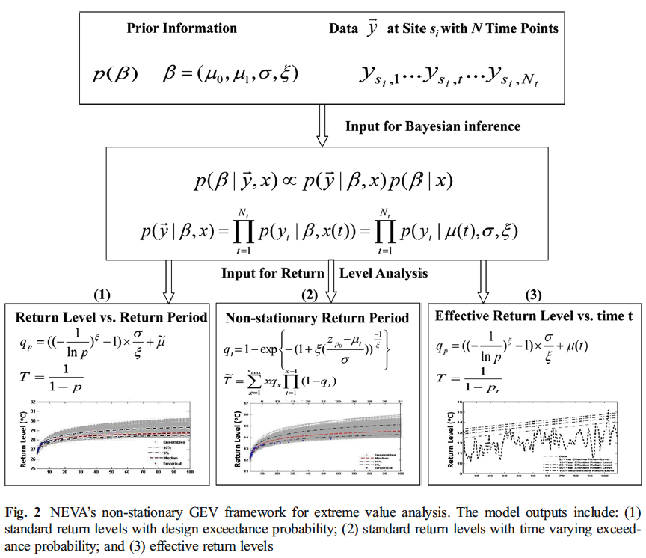
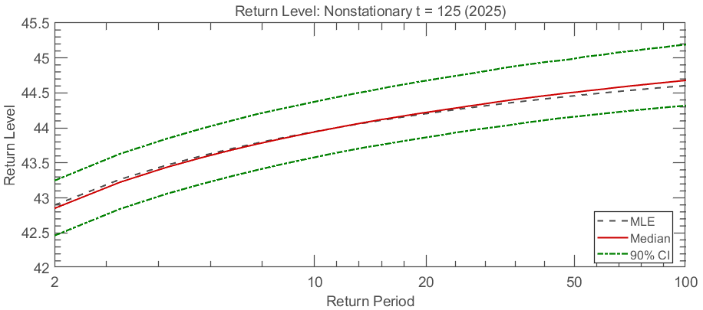
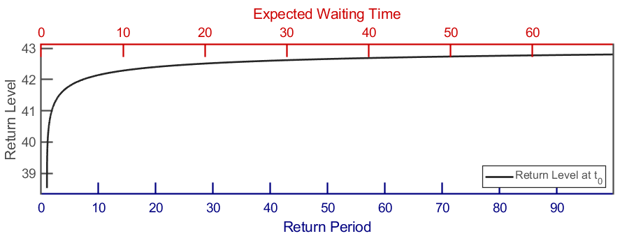
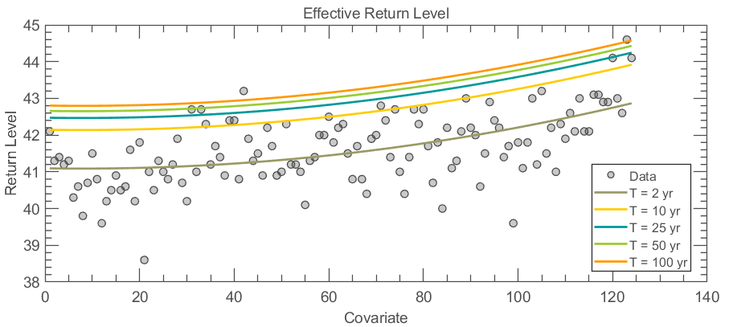
Expected waiting time
t

Slide 11

Theory: Model Comparison Metrics
Mann-Kendall trend test
A non-parametric test used to detect the presence of trends in extreme values without assuming any specific distribution.
White Test
A test used to check whether the variance is constant (homoskedastic) or not (heteroskedastic).
AIC/BIC
RMSE (Root Mean Squared Error)
NSE (Nash–Sutcliffe Efficiency)
Used in hydrology to assess predictive skill of a model relative to the mean.
Kolmogorov-Smirnov test
ReJection Rate (RJ Rate)
Percentage of K‑S resamples that reject the null hypothesis
RJ Rate ↓ => fit better

Slide 12
CASE STUDY
Notes:
Now we move on to a case study, which illustrates how the ProNEVA toolbox can be applied in a real-world context. The focus is on Phoenix, Arizona — a region increasingly affected by extreme heat events. This makes it an ideal location to analyze non-stationary behavior in extreme temperatures.

Slide 13
Data
Dataset: Gridded monthly temperature data from the Climatic Research Unit (CRU)
Time Span: 1901–2024
Variable Used: Monthly maximum temperature (tmx)
Spatial Resolution: 0.5° × 0.5° latitude–longitude grid
Data Processing:
Extracted annual maxima from monthly tmx values
Selected the grid cell covering the Phoenix, Arizona area for analysis
Notes:
The dataset used in this study comes from the Climatic Research Unit (CRU). It includes monthly gridded temperature data spanning from 1901 to 2024, with a resolution of 0.5° by 0.5° in latitude and longitude. We extracted the annual maxima from the monthly maximum temperature variable, and selected the grid cell corresponding to the Phoenix area for analysis

Slide 14
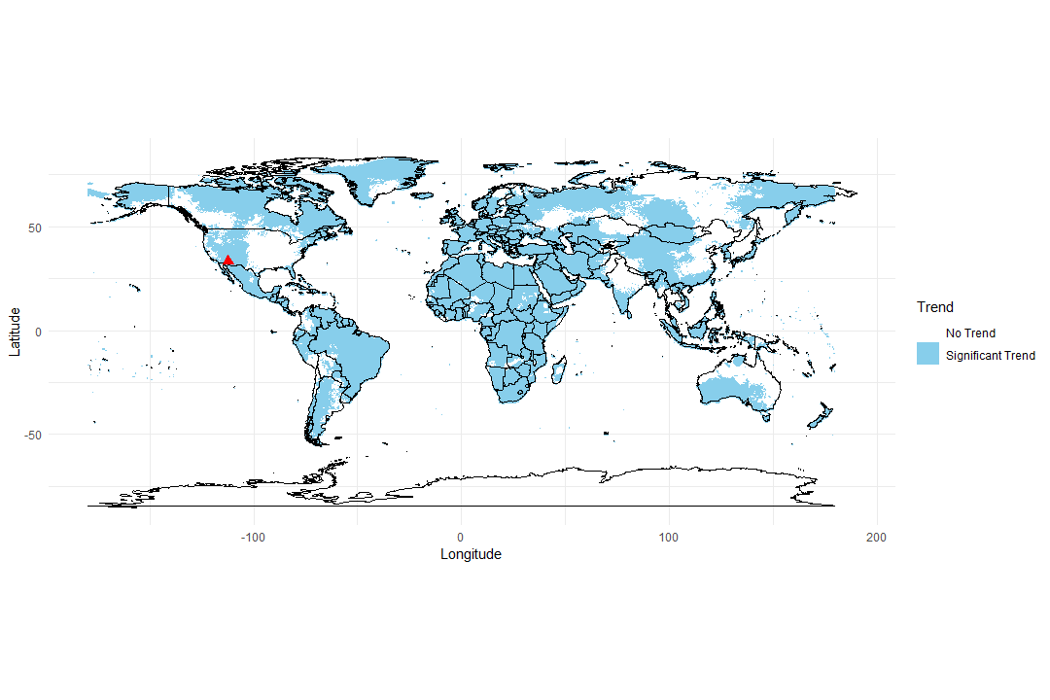
Analysis: Phoenix
(Latitude 33.45°N, Longitude 112.07°W)
MK
p=3.278444182797102e-10
WT
p=0.454703601913235
Notes:
This plot shows the annual maximum temperatures recorded for Phoenix over the past century. As we can see, there’s a clear trend. This trend provides motivation to test whether non-stationary models offer better predictive performance than traditional stationary models.

Slide 15
Analysis: Stationary vs Non-stationary
 | KS test RJ rate | AIC | BIC | RMSE | NSE
Stationary | 0.44 | 353.8965 | 362.3573 | 2.5825 | 0.9660
Linear mu | 0.32 | 311.6467 | 322.9279 | 2.3536 | 0.9730
Quad mu | 0.18 | 310.4963 | 324.5977 | 2.0349 | 0.9795
Exp mu | 0.3 | 311.4144 | 322.6956 | 2.0307 | 0.9789
Notes:
Here we compare a stationary model with three non-stationary models where the location parameter μ varies over time — linearly, quadratically, or exponentially. We evaluate them using metrics such as the KS test rejection rate, AIC, BIC, RMSE, and NSE. All non-stationary models outperform the stationary model, with the quadratic and exponential forms showing the best fit.

Slide 16
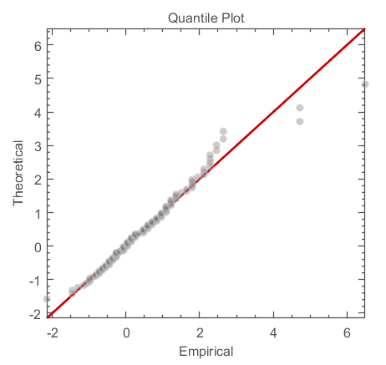
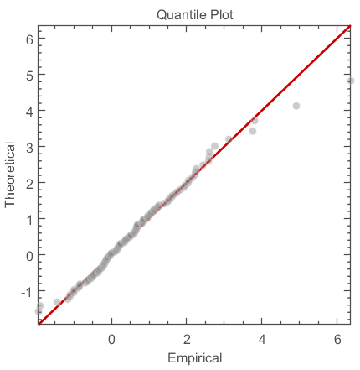
Analysis: Stationary vs Non-stationary
Notes:
This visual comparison highlights how each model fits the data. The stationary model underestimates extremes in recent years, while the non-stationary models are able to track the rising trend. This demonstrates the importance of accounting for changing behavior over time.

Slide 17
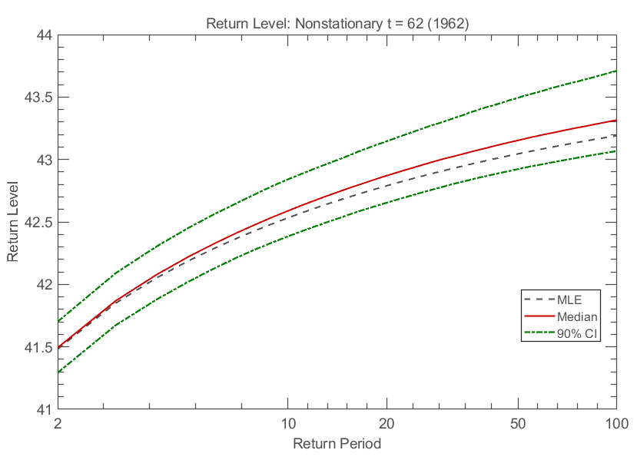
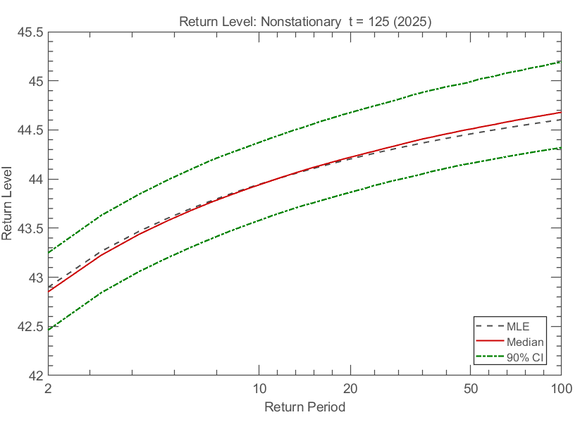
Analysis: Non-stationary
Notes:
Here we focus specifically on the non-stationary location parameter μ. The trend in μ indicates a significant shift in the distribution's center over time. This implies that extreme high temperatures are becoming more common, and the entire distribution of extremes is shifting rightward.

Slide 18
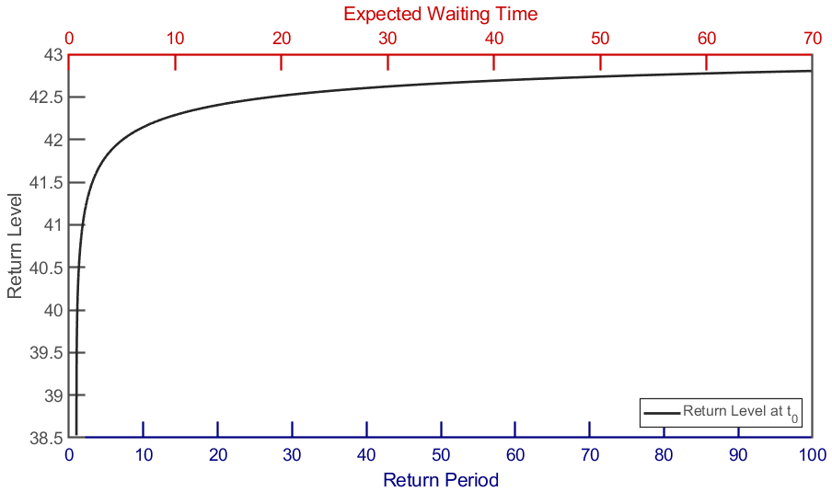
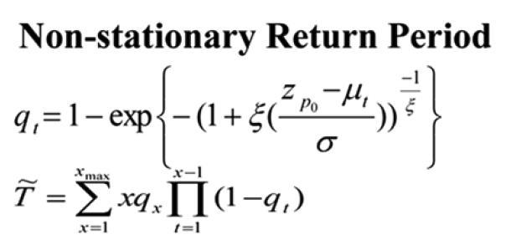
Analysis: Non-stationary
Notes:
Using the non-stationary models, we examine how return levels and return periods change. For example, here for a 10 yr return period, we have a expected waiting time less than 10 yrs. This reflects the increasing risk of extreme temperature events over time.

Slide 19
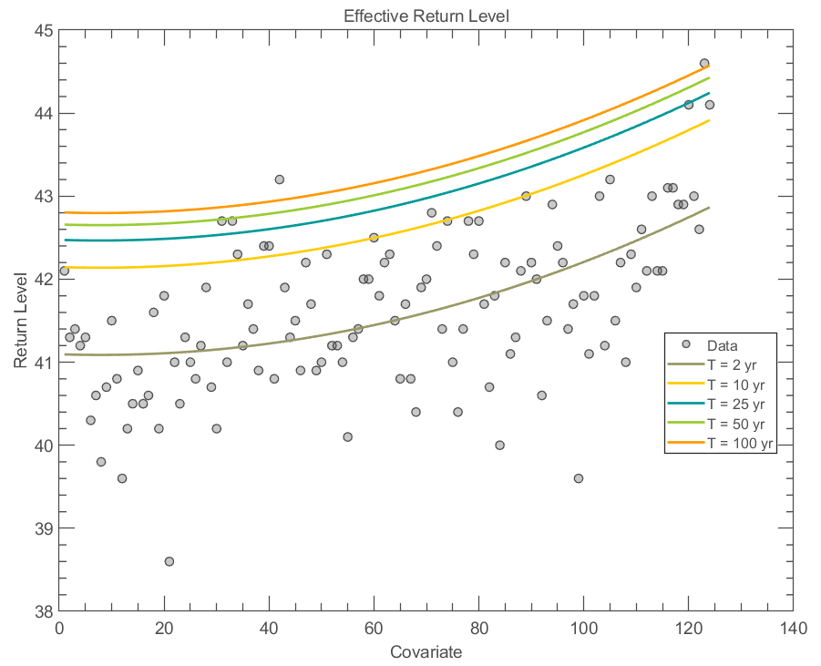
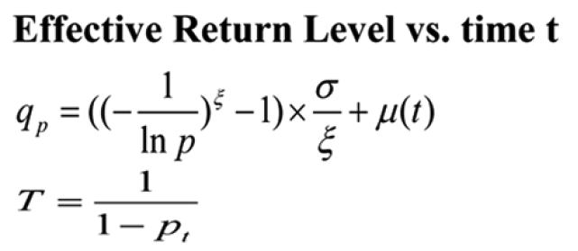
Analysis
Notes:
This diagram shows that when we fix the return period, we can see a increasing trend of return level over time.

Slide 20
Discussion
“… care should be taken in extrapolating historical trends into the future, especially for long-term projections of extremes. On the other hand, long term projections may be affected by very different natural and anthropogenic drivers than the past.” (Cheng et al., 2014)
Notes:
However, caution is necessary. As the authors pointed out, historical trends should not be blindly extrapolated into the future. Future climate conditions may be influenced by entirely different natural and human-driven factors. So while non-stationary models are powerful, we must be careful in how we apply them for long-term projections.
So let’s say that the future temperature may be affected by greenhouse gas, and we don’t know if the greenhouse gas emission will increase or not in the future. if global climate policy tightens or technology shifts to renewables, emission trends could reverse. Conversely, if mitigation fails, warming could accelerate. As a result, if warming slows down and we are still using the original fitting, we may overestimate the risk and reserve more money instead of investing it. And conversely, we may underestimate, which may cause a bankrupt.

Slide 21

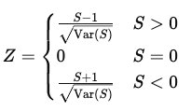
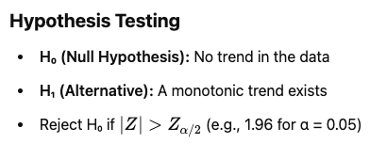
Appendix: Mann-Kendall trend test
Continuity correction
A small adjustment (usually ±0.5 or ±1) made when a discrete distribution is approximated by a continuous distribution

